Slide 1
Prototype & Bridge
Design Patterns
- Shakti Suman

Slide 2
Prototype Design Pattern
Prototype pattern refers to creating duplicate object while keeping performance in mind.
This type of design pattern comes under creational pattern as this pattern provides one of the best ways to create an object.
Specify the kinds of objects to create using a prototypical instance, and create new objects by copying this prototype

Slide 3
When to Prototype..?
When product creation should be decoupled from system behavior.
When to avoid subclasses of an object creator in the client application .
When creating an instance of a class is time-consuming or complex in some way.

Slide 4
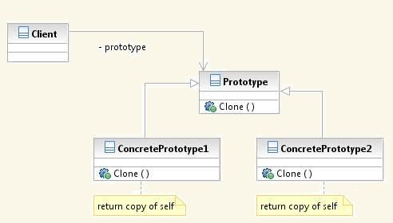
Under the Hood:
Prototype declares an interface for cloning itself.
ConcretePrototype implements an operation for cloning itself.
Client creates a new object by asking a prototype to clone itself.

Slide 5
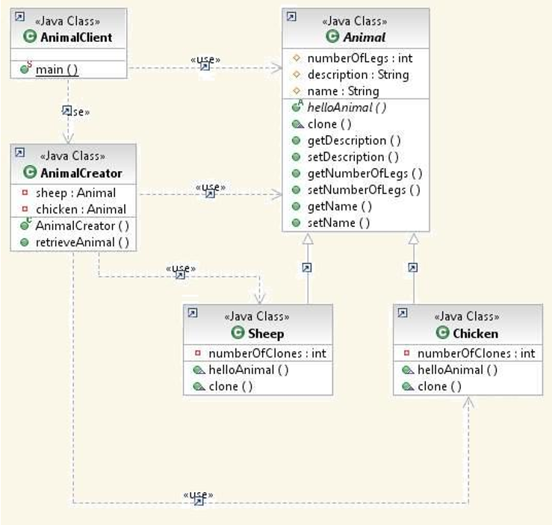
OK, The Animal Farm Example!

Slide 6
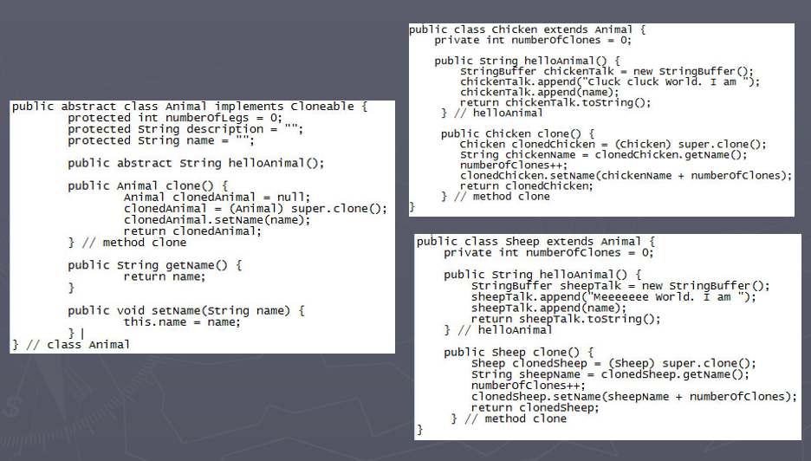
Prototype code

Slide 7
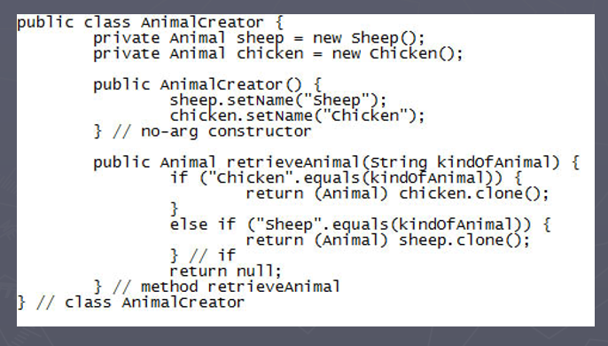
Using the Prototype

Slide 8
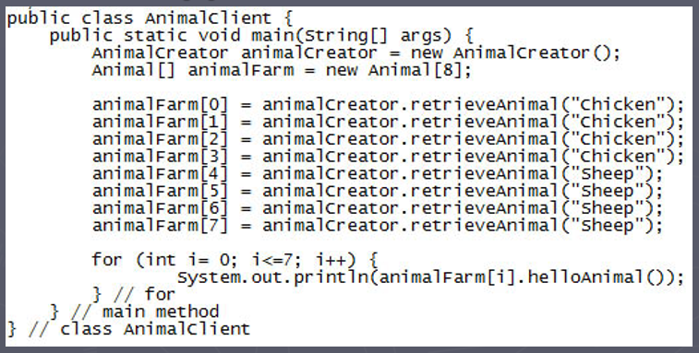
Finally, using all the construct
Optimal Code will have a HashMap<String, Animal> in AnimalCreator.
Early creation can create and store clones and return when asked for.
Lazy creation will do nothing until a client code asks for something and then create and store clones in HashMap<String, Animal>.

Slide 9
Final Word!
Benefits:
Hides the concrete product classes from the client
Adding/removing of prototypes at run-time
Allows specifying new objects by varying values or structure
Reducing the need for sub-classing
Drawbacks:
It is built on the method .clone(), which could be complicated sometimes in terms of shallow copy and deep copy.
Classes that have circular references to other classes cannot really be cloned.

Slide 10
Bridge Design Pattern
Bridge is used when we need to decouple an abstraction from its implementation so that the two can vary independently.
This type of design pattern comes under structural pattern as this pattern decouples implementation class and abstract class by providing a bridge structure between them.
This pattern involves an interface which acts as a bridge which makes the functionality of concrete classes independent from interface implementer classes. Both types of classes can be altered structurally without affecting each other.

Slide 11
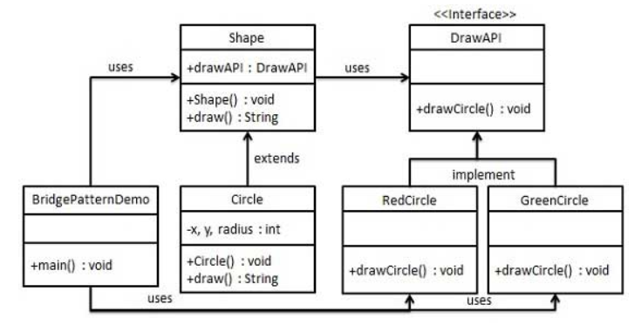
An Example

Slide 12

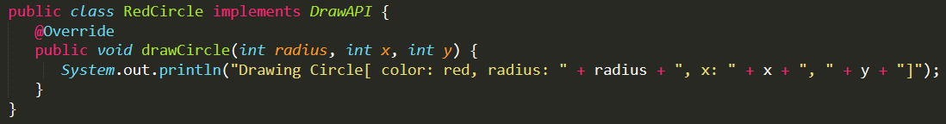
Coding!
First thing to do is to create a bridge implementer interface, say DrawAPI.java
Next, create concrete bridge implementer classes implementing the DrawAPI interface: RedCircle.java
Now, if a new implementation has to be added, e.g. a GreenCircle, it will just implement DrawAPI and nothing to do with the Shape abstract class.

Slide 13
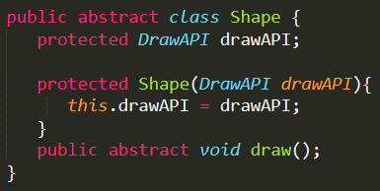
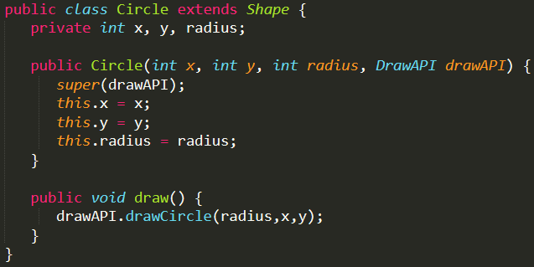
More!
Now, create an abstract class Shape using the DrawAPI interface we already have: Shape.java
Then, create concrete class implementing the Shape interface: Circle.java

Slide 14
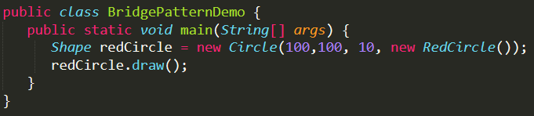
Finally…
Use the Shape and DrawAPI classes to draw different colored circles: BridgePatternDemo.java
With output:

Slide 15
Final Word!
Benefits with this Pattern:
Bridge pattern decouple an abstraction from its implementation so that the two can vary independently.
It is used mainly for implementing platform independence feature.
It adds one more method level redirection to achieve the objective.
Publish abstraction interface in a separate inheritance hierarchy, and put the implementation in its own inheritance hierarchy.
Use bridge pattern to run-time binding of the implementation.
Use bridge pattern to map orthogonal class hierarchies
Bridge is designed up-front to let the abstraction and the implementation vary independently.
Problems with this Pattern:
Increased complexity due to over use of HAS-A principle
Interfaces with only single implementation
Multiple indirection

